Slide 1
Ultimate
Gumball
Machine
Objective: Create a machine that will sort gum balls in the shortest amount of time!
Junk Box Wars @ http://sciencespot.net/

Slide 2


Think About It …
How does a coin sorter work?
Watch the two videos to learn more!
Coin Sorter
Machine
Nadex Coin Sorter
Could we use this same idea to sort gumballs?

Slide 3
Competition Rules:
Each team will be provided with a junk box filled with materials that could be used to create a bubble gum machine. Each team will receive only set of materials. Teams may use all or part of the materials in their junk box and are not allowed to share materials with other teams. All unused materials should be saved in case repairs are needed during competition.
Teams will be allowed time to build and test the machine. Competitors are allowed to bring diagrams to help during the building time. After the time is up, the device will be impounded and no changes will be allowed.
Machine Requirements:
The machine must be able to sit unaided on the testing platform or table. Your machine must also have three individual containers to hold the sorted gumballs with labels for small, medium, and large. The entry point for the gumballs must be at least 30 cm from the testing
platform or table. All gumballs must enter at the same location.
NOTE: You are not allowed to make any changes to the machine during the sorting process; however, you may load gumballs one-at-a-time, several at a time, or all at once.

Slide 4
Testing Procedure:
Each team will be allowed 5 minutes to prepare their machine for competition. Each team will be allowed three trials with 5 minutes provided between trials for repairs and adjustments using materials left over from construction.
Scores will be calculated based on the number of gumballs sorted correctly. The best trial will be considered for final scoring. The team with the most gumballs sorted correctly will be declared the winner. The shortest time out of the three trials will be considered in the case of a tie. Team members are not allowed to touch or shake the device or gumballs during a trial. Any interference will result in a loss of points for that trial.

Slide 5
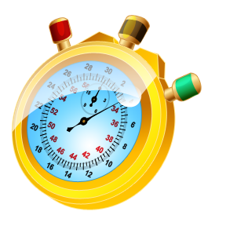
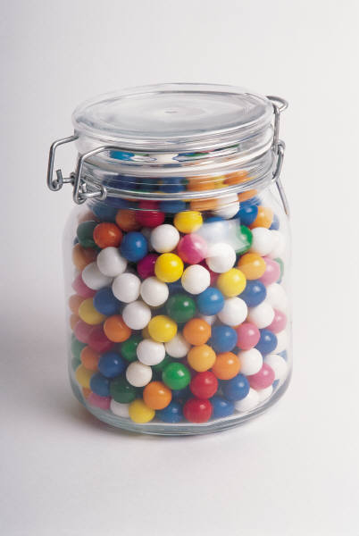
You will have 60 minutes to design, build, and test your device. After the time is up, all devices will be impounded and the competition will begin.
Online Stopwatch
Questions?

