Slide 1
Bridge Challenge
Objective: Build a bridge that will support the most weight!
Junk Box Wars @ http://sciencespot.net/

Slide 2
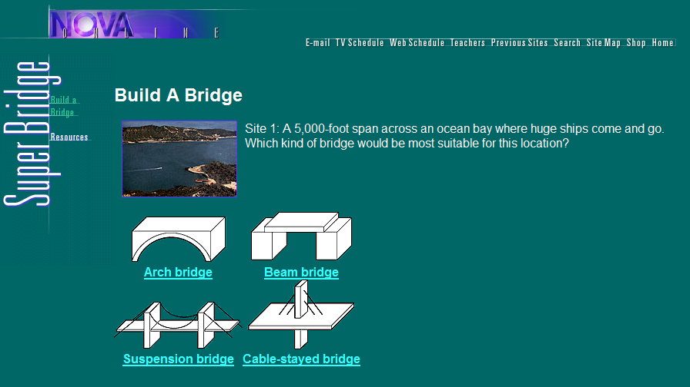
How are bridges designed?
Let’s examine some bridges!
Think About It …
Which style will work best for our challenge?
What forces will we have to worry about?
What other design issues we will need to consider?

Slide 3
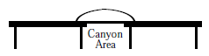
Competition Rules:
Each team will be provided with a junk box filled with materials that may be used to build a bridge. Each team will receive only one set of materials! Teams may use all or part of the materials provided and are not allowed to share materials with other teams. Scissors and hot glue guns will be provided by the teacher.
Teams will be allowed time to build and test their bridges. Competitors are allowed to bring diagrams to help them build their bridges. After the time is up, all bridges will be impounded and no changes will be allowed!
Structure Requirements:
The bridge must be able to span the entire width of the canyon or space between two tables. Bridges may be attached to the sides of the canyon with tape. Bridges must also be constructed with a smooth road bed and enough room to allow the vehicle to move freely along the entire length of the bridge.

Slide 4
Testing Procedure:
Teams will begin testing using an empty vehicle. The vehicle must be pulled over the complete length of the bridge to be counted as a successful trial. If the bridge supports the empty vehicle, team members will add more mass and continue
the testing process.
At the time that the bridge fails to support the vehicle and the load, testing will
be done. Bridge failure is defined as breaks in the road bed or structure that prevents the vehicle from traveling over the bridge. In the event that the vehicle
leaves the bridge structure, testing will be done.
The team with the bridge that supports the largest mass will be declared the
winner. In the case of a tie, the team with the lightest bridge will be declared the
winner.

Slide 5
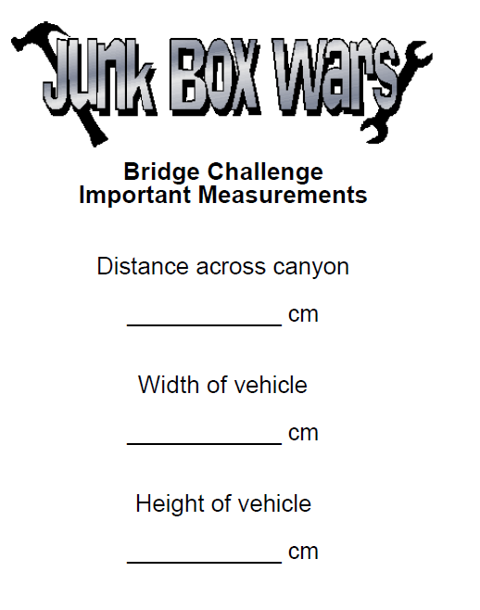
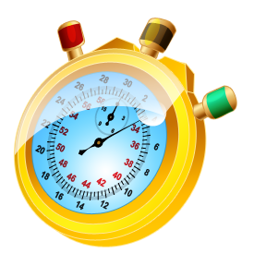
Use the measurements provided to help you design and build your bridge.
Your team will have 60 minutes to create your bridge.
Questions?
Online Stopwatch

