Slide 1
Bottle Blasters
Objective: Build a device that will launch a ball to knock over bottles and earn the most points!
Junk Box Wars @ http://sciencespot.net/

Slide 2
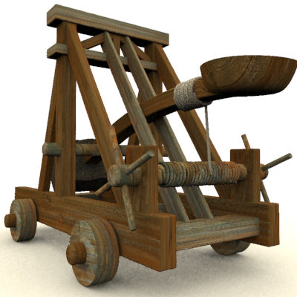
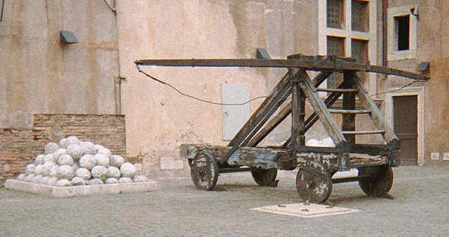
What is a catapult?
A catapult is a device which uses an arm to hurl a projectile a great distance and were often used in ancient times during battle.
What other devices might be used to launch bouncy balls? Refer to your materials list for ideas!

Slide 3
Competition Rules:
Each team will be provided with a junk box filled with materials to build your blaster. Each team will receive only one set of materials! Teams may use all or part of the materials provided and are not allowed to share materials with other teams. Scissors will be provided by the teacher.
Teams will be allowed time to build and test their devices. Competitors are allowed to bring diagrams to help them build their blasters. After the time is up, all devices will be impounded and no changes will be allowed!
Structure Requirements:
Blasters may be any type of slinging device, such as catapults or sling shots, but must be powered by the energy in the elastic devices or structure. Projectiles cannot be aided by a helping hand or extra push.
Blasters must also be designed so that a single person can launch them.
They cannot be held by other team members during a trial. Teams are allowed to secure the device to the floor with masking tape provided the surface is not damaged.

Slide 4
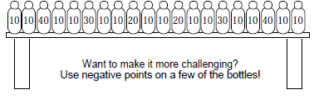
Testing Procedure:
Each team will be allowed 5 minutes to prepare for each trial. Teams will be allowed to make repairs and modifications using the remaining materials in their junk box. Teams who go over the five minute time limit will forfeit the following round.
Teams will be allowed three two-minute trials to earn points. The device must remain behind the launch area boundary throughout the trial. Each team will receive 5 bouncy balls for each trial. Team members may retrieve the balls during the trial, but cannot enter the launch zone while balls are being launched.
Points will be awarded based on the point values of the bottles knocked off the testing platform. The team with the most points will be declared the winner. In the case of a tie, teams will be allowed an additional one-minute trial. The team with the most points in the tie-breaking round will be declared the winner.

Slide 5
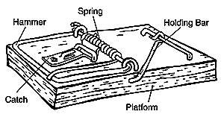
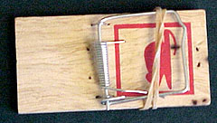
Think About It ...
How can we modify a mousetrap or other materials to create a launching device?
Build It!
Step 1: Sketch your device.
Step 2: Use your materials to build a launching device and then test it.
Step 3: Analyze your results. How does it do?
Step 4: What changes do you need to make to improve your device? Make modifications and test it again.
Worried about getting “snapped”? Use a rubberband to hold down the “hammer” of the mousetrap while you are building your catapult or unwrap the small wires holding down the sides of the arm.

Slide 6
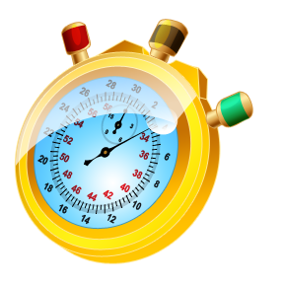
You will have 60 minutes to design, build, and test your device. After the time is up, all devices will be impounded and the competition will begin.
Online Stopwatch
Questions?

