Slide 1
Battle of the Boats
Objective: Create a boat that will travel a specified distance in the shortest amount of time.
Junk Box Wars @ http://sciencespot.net/

Slide 2

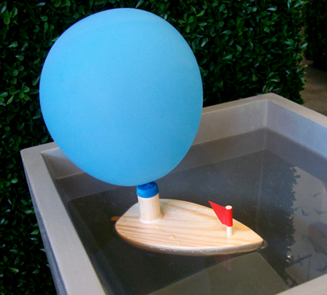
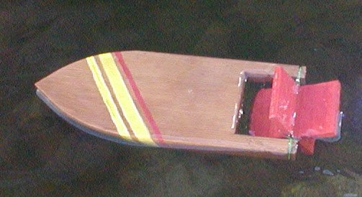
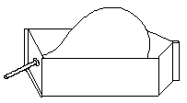
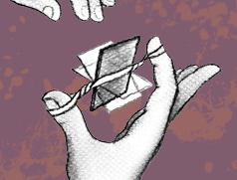
Think About It
How can we power a boat using
a balloon or rubberbands?
What modifications could you make to these designs to make them work better?

Slide 3
Competition Rules:
Each team will be provided with a junk box filled with materials that could be used to create your boat. Each team will receive only one set of materials. Teams may use all or part of the materials in their junk box and are not allowed to share materials with other teams. All unused materials should be saved in case repairs are needed during competition. Teams will be allowed time to build and test their boat. Competitors are allowed to bring diagrams to help them build their boat. After the time is up, all boats will be impounded and no changes will be allowed.
Machine Requirements:
Your boat must be powered by the air stored in a balloon or the energy stored in the rubber band(s). The boat may not be aided by a helping hand or other energy source.
At least one-half of your boat must be above the water. Height will be measured from the bottom of the hull to the top edge of the boat. Objects extending past the top level will not be included in the height.

Slide 4
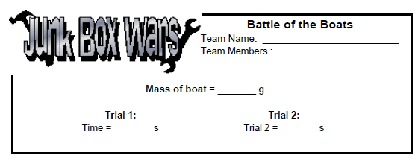
Testing Procedure:
Each team will be allowed 5 minutes to “power up” their boats for the first trial. Teams are not allowed to add additional air or rewind the rubber band(s) during the race. No electric winders or air pumps are allowed.
Each team will be allowed two trials with 5 minutes allowed between trials to inflate the balloon or rewind the rubber band(s) and to make repairs and adjustments using materials left over from construction.
The best time out of the two trials will be considered for final results. If the boat fails to make it to the finish line, no points will be awarded for that trial. The lightest boat will be declared the winner in case of a tie.

Slide 5
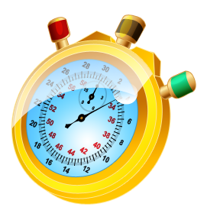
You will have 60 minutes to design, build, and test your device. After the time is up, all devices will be impounded and the competition will begin.
Online Stopwatch
Questions?

