Slide 1
Super
Structures
The challenge …
Build the structure that will hold the most pennies!
HJHS Science Club Event
January 2010

Slide 2
Competition Rules
Each team will be provided with a junk box filled with materials to build a super structure. Each team will receive only one set of materials!
Teams may use all or part of the materials provided and are not allowed to share materials with other teams. Scissors will be provided by the teacher.
Teams will be allowed time to build and test their structures. Competitors are allowed to bring diagrams to help them build their structures.
After the time is up, all structures will be impounded and no changes will be allowed!

Slide 3
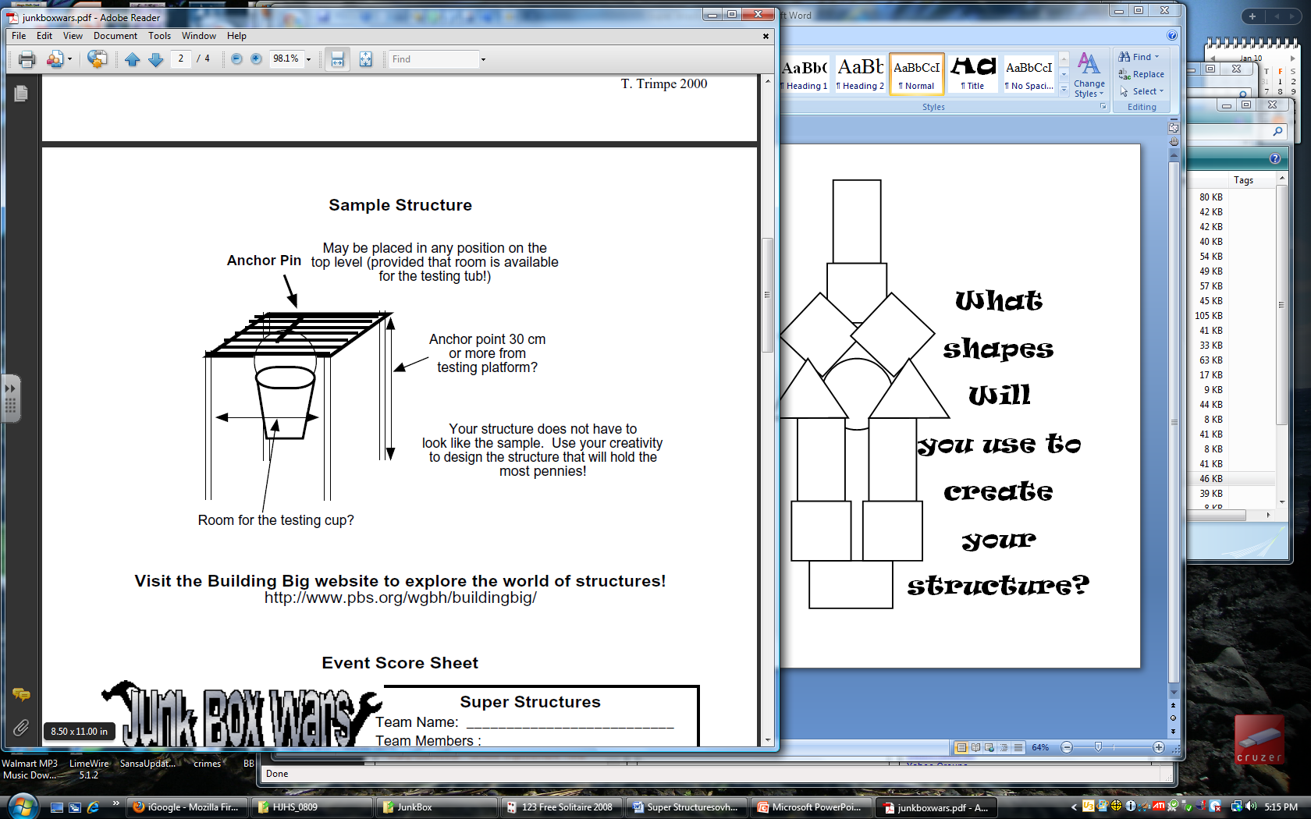
Structure Requirements
The structure must be able to sit unaided on the table or testing platform and may not be taped or attached to the table in any way.
Structures must have an anchor point that is at least 30 cm from the testing platform (top of the table).
Structures must be wide enough to allow room for the testing cup so that it does not touch any part of the structure or the table during the testing process!

Slide 4
Testing Procedure
After the testing cup has been attached to the anchor point, team members will begin adding pennies to the testing cup one at a time. After the first penny has been added, no adjustments are allowed!
At the time that the structure appears to have reached its maximum load, teams may be asked to wait 5 seconds before adding additional pennies. Dumping extra pennies into the cup at the last minute is not allowed!
Testing will be done when (1) the testing cup touches the table, (2) the testing cup touches any part of the structure, or (3) a penny falls out of the cup. The structure that holds the highest overall mass will be declared the winner! In case of a tie, the lightest structure will be the winner.

Slide 5
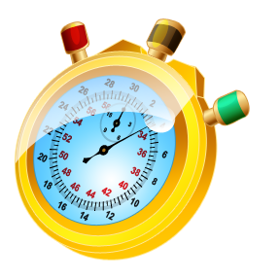
Questions?
Step 1:
Get your materials
Step 2:
Make a plan
Step 3:
Build your structure
Materials List
30 wooden sticks
30 pipe cleaners
30 straws
20 rubber bands
20 index cards
7 pencils
5 cups
+
Up to 500 cm of
masking tape
Online Stopwatch

