Slide 1
PHET Projectile Motion Lab
How does the height, mass, speed, and other variables affect how far a projectile can travel and its trajectory?
Go to mrstomm.com → MORE → Projectile Motion
READ THE DIRECTIONS ON THE WORKSHEET AS YOU WAIT QUIETLY FOR YOUR TEACHER TO CONTINUE.
T. Tomm 2018 http://sciencespot.net/

Slide 2
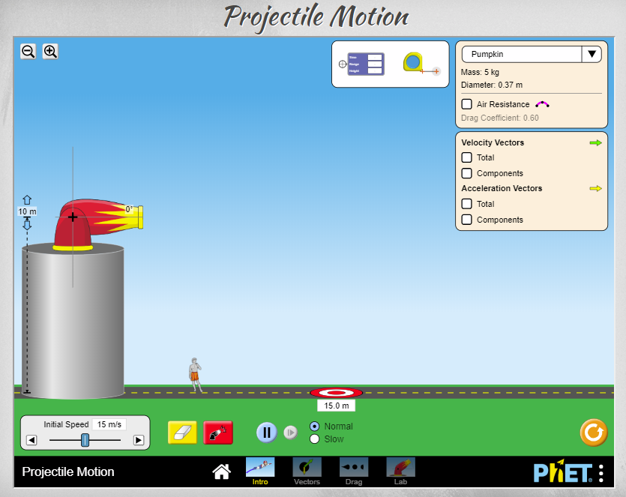
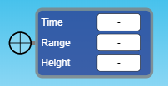
Click INTRO and FOLLOW your teacher’s directions.
Zoom Tools
Projectile
Cannon Angle
Set to 45º
Cannon Height
Set to 5
Drag the crosshairs over the projectile & use the range for distance
Click to Fire
Speed
Set to
30 m/s
Click to RESET
Click to clear
INTRO & VECTOR

Slide 3


You do not need to hit the target on the tests (#1-4) - you are just collecting data!
DIRECTIONS
1st - Complete all the tests AND write answers to the questions.
(Remember - Use INTRO for Tests 1 – 3 & go to VECTOR for Test 4)
2nd – Discuss what you learned with your tablemates.
3rd - Work on the Final Challenge together – go back to the INTRO version.
Use pumpkin for the first projectile
Choose two other projectiles other than pumpkin!
Super Duper Challenge – What is the furthest you can get a projectile to go?
Extra time? Search online for ideas for your mousetrap catapult!

Slide 4
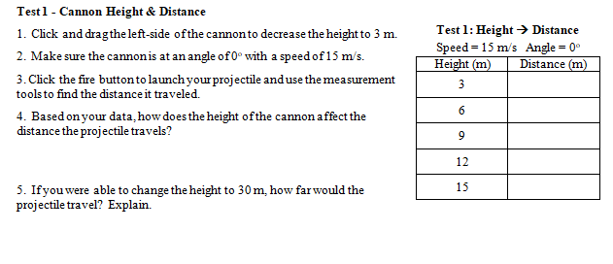
Test 1 –Cannon Height & Distance
How does the height of the launch affect the distance a projectile will travel?
Constants → Speed = 15 m/s, Angle = 0
Independent Variable → Launch height
Dependent Variable → Distance
You do not need to hit the target on Tests 1 – 4 – you are just collecting data!

Slide 5
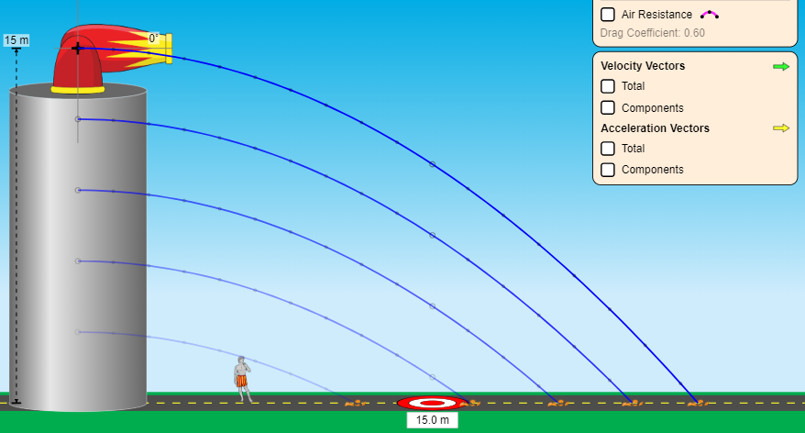
Test 1 Results

Slide 6
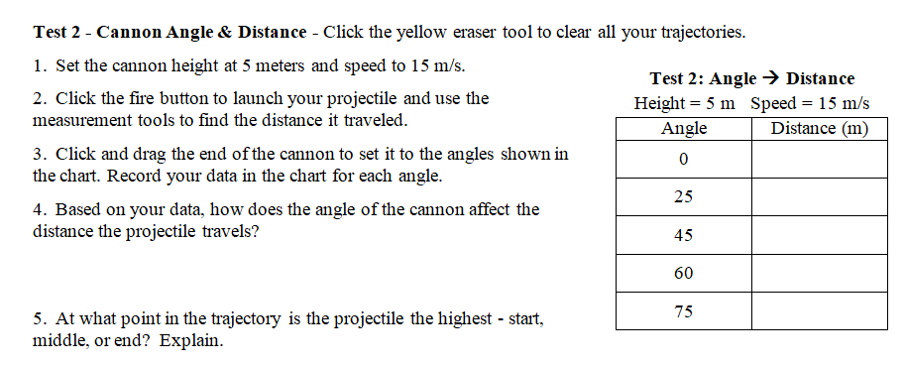
Test 2 – Cannon Angle & Distance
How does the angle of the launch affect the distance a projectile will travel?
Constants → Height = 5 Speed = 15 m/s
Independent Variable → Launch angle
Dependent Variable → Distance

Slide 7
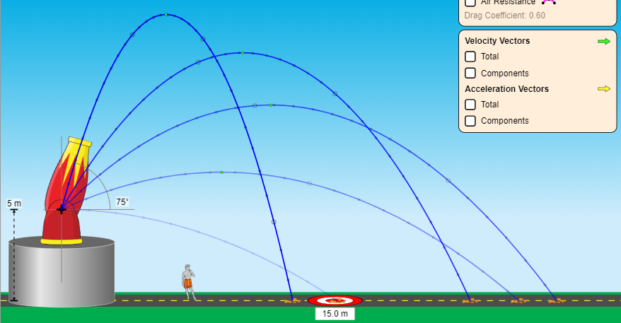
Test 2 Results

Slide 8
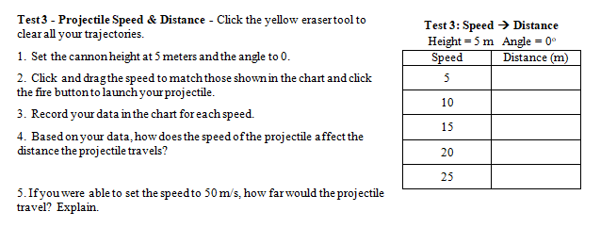
Test 3 – Projectile Speed & Distance
How does the speed of the projectile affect the distance it will travel?
Constants → Height = 5, Angle = 0
Independent Variable → Speed
Dependent Variable → Distance

Slide 9
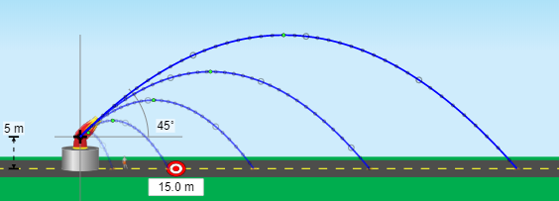
Test 3 Results

Slide 10
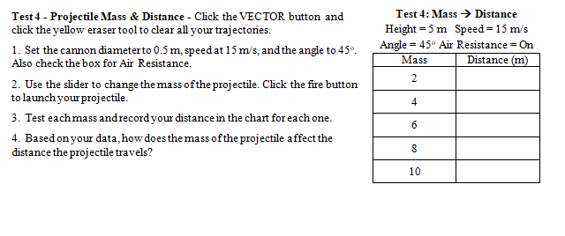
Test 4 – Projectile Mass & Distance
How does the mass of the projectile affect the distance it will travel?
Constants → Height = 5, Speed = 15, Angle = 45
Air Resistance – On
Independent Variable → Projectile Mass
Dependent Variable → Distance

Slide 11
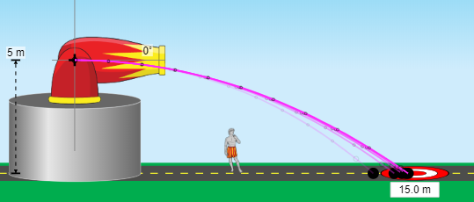
Test 4 Results

Slide 12
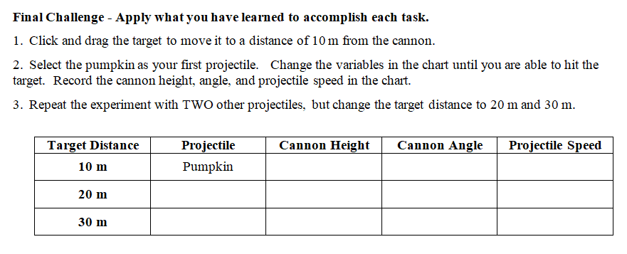
Final Challenge – Were you able to get all 3 star target hits?
What variables did you change?

